Slide 1
Urban-Rural Cost Allocation Options
Kai Monast
ITRE Public Transportation Group
kcmonast@ncsu.edu
(919) 515-8768

Slide 2
Overview
Purpose: Intentionally develop urban-rural cost allocation plans that meet the needs of each transit provider
Why? FTA requires that transit systems develop a reasonable and consistent methodology based on service being delivered

Slide 3
Ramifications
Urban/Rural split methodology informs NTD reporting
NTD reporting informs funding
Rural service increases State allocation
Large Urban service increases MPO allocation
Funding sources determine how you manage your system

Slide 4
Relationship to Cost Allocation Model

Slide 5
Determining Urban Service
There is no ‘right’ answer
Goals:
Reasonable and consistent- REQUIRED
Simple to collect and report- DESIRED
Maximize funding- DESIRED

Slide 7
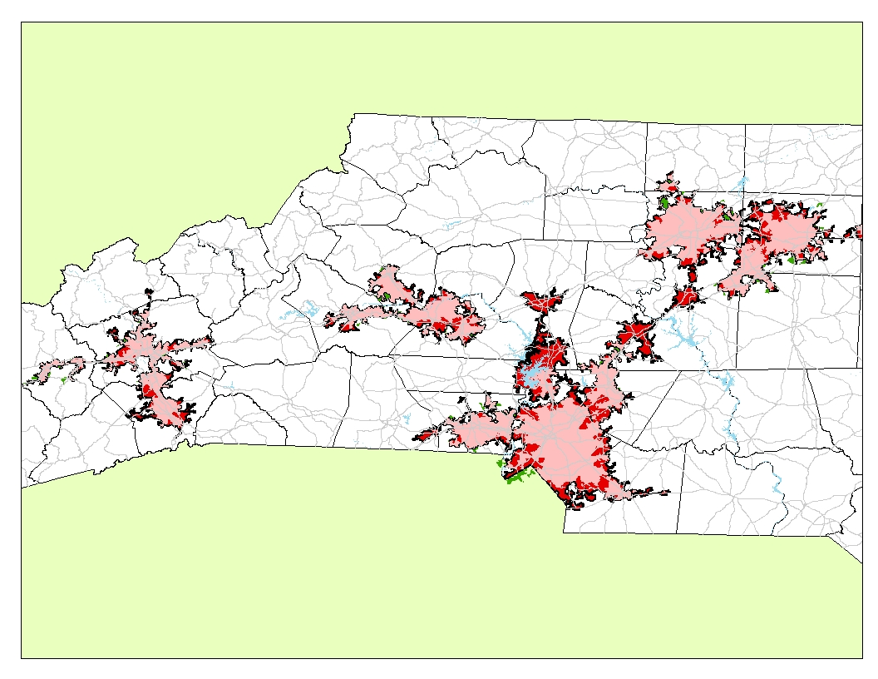

Slide 8
Options
Trip Ends
One trip end in rural area = rural trip
Customer Home
Customer home in rural area = rural trip
Urban and rural routes, regardless of who rides or where
Proportionalize routes based on distance or time inside the rural area

Slide 9
Trip Ends
One end in the rural area = rural
1 rural, 1 urban trip
Home
Rural Area
Urban Area
Rural Pickup
Urban Pickup
Rural Dropoff
Doctor
Urban Dropoff
Route
Pharmacy

Slide 10
Customer Home
Trips are coded based on whether the home is rural or urban
2 rural trips
Home
Rural Area
Urban Area
Rural Pickup
Rural Dropoff
Doctor
Route
Pharmacy

Slide 11
Urban and Rural Routes
Which group is the primary target of the service?
2 rural, 3 urban trips
Rural Area
Urban Area
Rural Pickup
Incidental
Urban Pickup
Rural Dropoff
Urban Dropoff
Rural Route
Urban Route
Incidental

Slide 12
Proportionalize Routes
Split time or miles for each route
2 rural, 3 urban trips
Rural Area
Urban Area
Rural Pickup
Incidental
Urban Pickup
Rural Dropoff
Urban Dropoff
Rural Route
Urban Route
Incidental

Slide 13
Mode Splits
The methods may differ if modes have different characteristics
2 rural, 3 urban trips
DR based on customer home
FR based on route
DR Route
FR Route

Slide 14
Multiple Urban Areas
No choice if the service is contained within one urban area
UA 1 = 2 trips
UA 2 = 2 trips

Slide 15
Multiple Urban Areas
All options are available
?

Slide 16
Options Summary
Trip Ends- One trip end in rural area = rural trip
Requires coding by trip origin/destination
Easy with GIS-based routing software
Favors urban service over customer home method
Customer Home- Customer home in rural area = rural trip
Requires coding by customer home
Easy with any software
Favors rural service over trip ends method
Urban and rural routes, regardless of who rides or where
Requires coding by route and consistent routes
Software may not handle this directly
Favors? Depends on route structure
Proportionalize routes based on distance or time inside the rural area
Difficult
Requires post-processing of GPS data
Favors? Depends on route structure

Slide 17
How to Choose
Large Urban miles result in MPO 5307 funding
Worth 10x more than rural miles
Will you get the money from the MPO?
Even if you receive less than what you ‘earn’, is it greater than 10%?
Administrative budget impacts
Small Urban miles result in zero additional 5307 GA funding
Rural miles result in State 5311 funding
Must be careful where 5311 subsidies are applied

Slide 18
Thought Exercise
70% urban, 30% rural vs. 30% urban, 70% rural
Relationship with the MPO
Full apportionment of 5311 funds, but 5311 administrative budget should only cover rural portion of administrative expenses
How will the remainder must be covered?
Impacts on operating subsidy

Slide 19
Take-Aways
Reasonable and consistent- cannot change often
Based on actual service being delivered
Lots of flexibility
The results matter
There is not one solution that is best for everyone

Slide 20
Discussion Questions
What is your strategy?
How are you compiling the data?
How are you managing the changes in administrative and operating funding?

